Slide 1
Flash Card Application
Group 9: Campos, Liu, Ridder, Silvernail

Slide 2
Roles
Blake: Project Management/Front-End Development
Saally: Project Management/Front-End Development
Tony: Back-end Development/Testing
Adrian: Documentation

Slide 3
Languages/Technology
C# and .NET
HTML/CSS
Microsoft SQL Server

Slide 4
Focus Since Prototype
Integrating each piece of functionality
1
Establishing common look and feel across the platform
2
Testing and error correction
3
Unit Testing and Manual System Testing

Slide 5
Progress Since Prototype

Slide 6

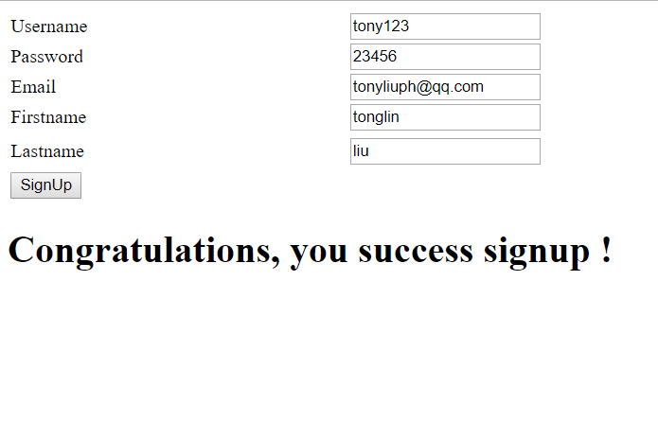
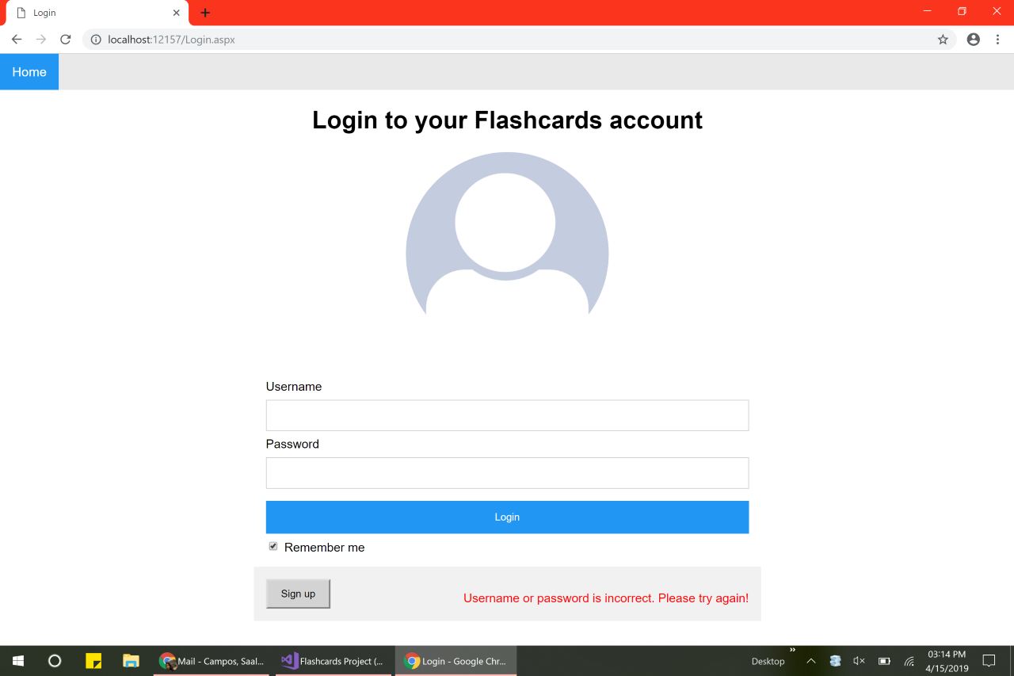

Slide 7
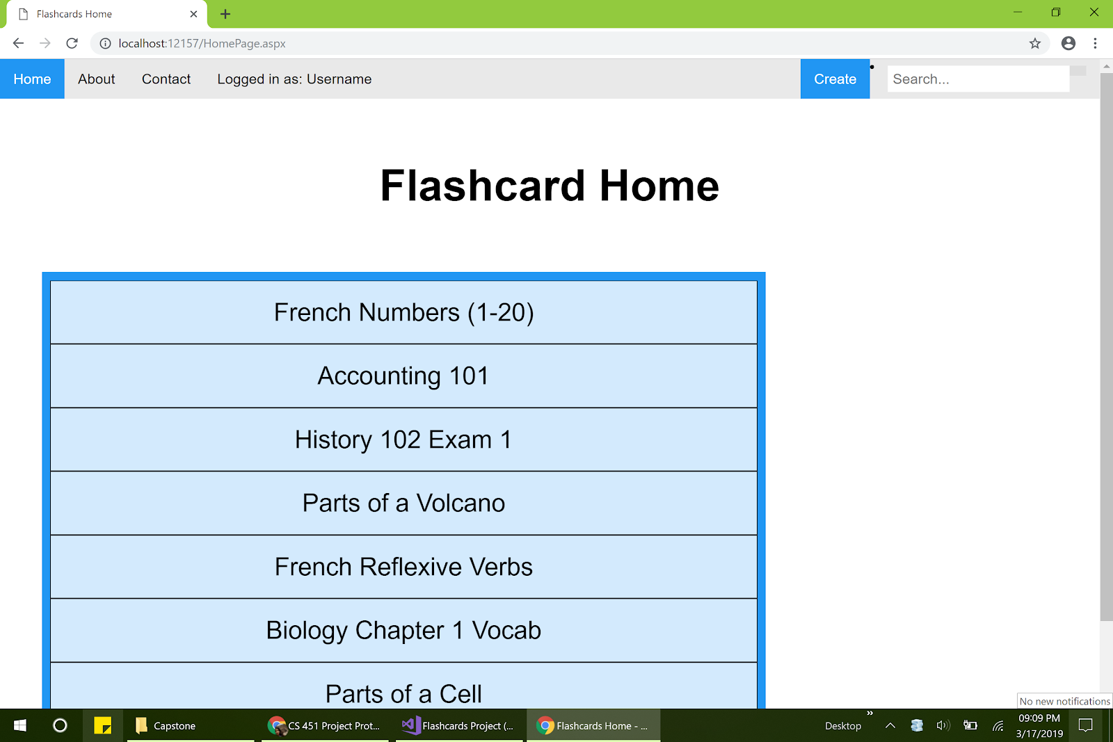
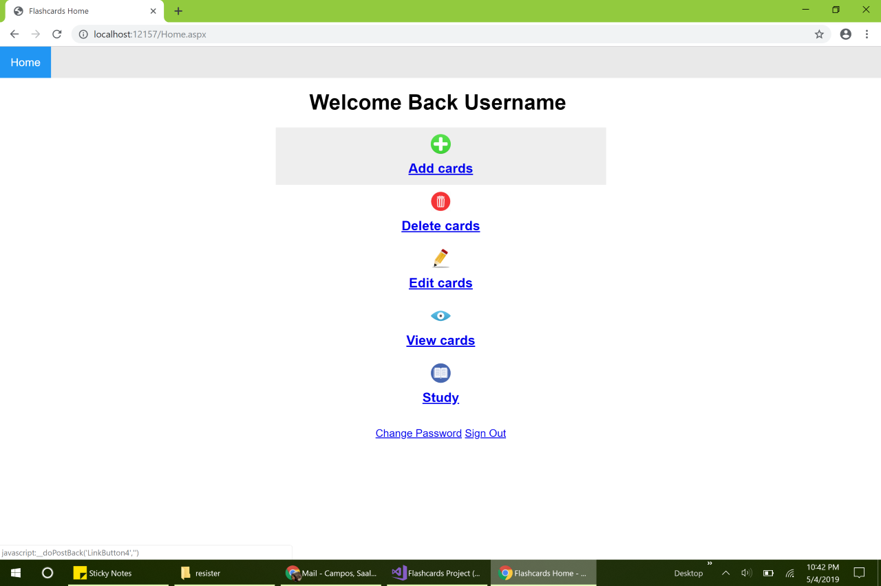

Slide 8
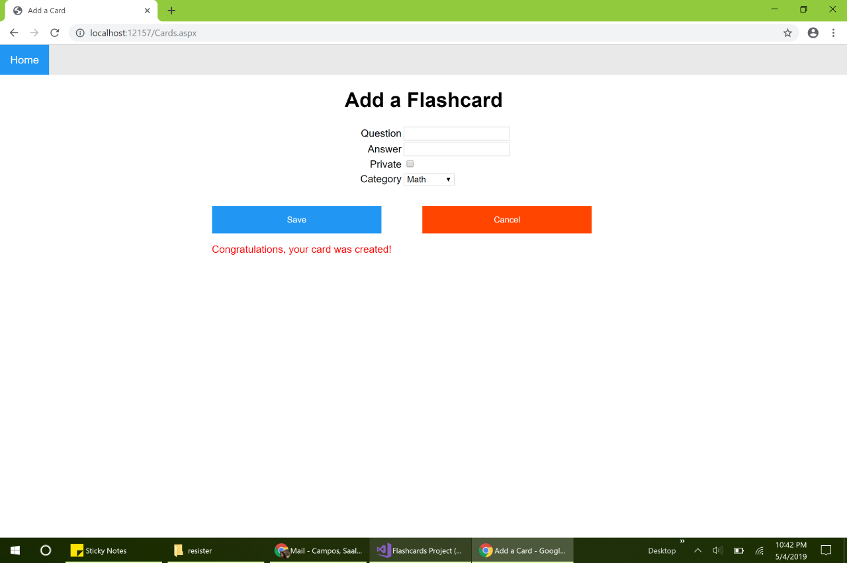
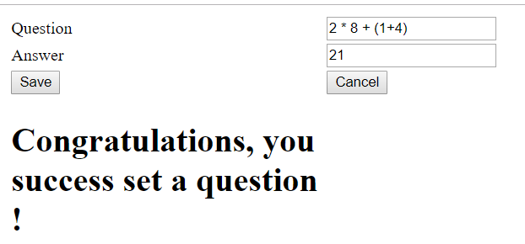

Slide 9
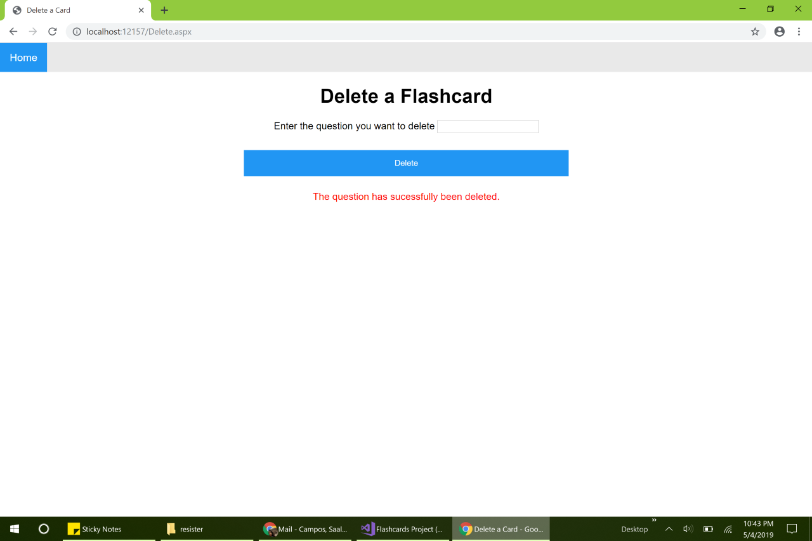
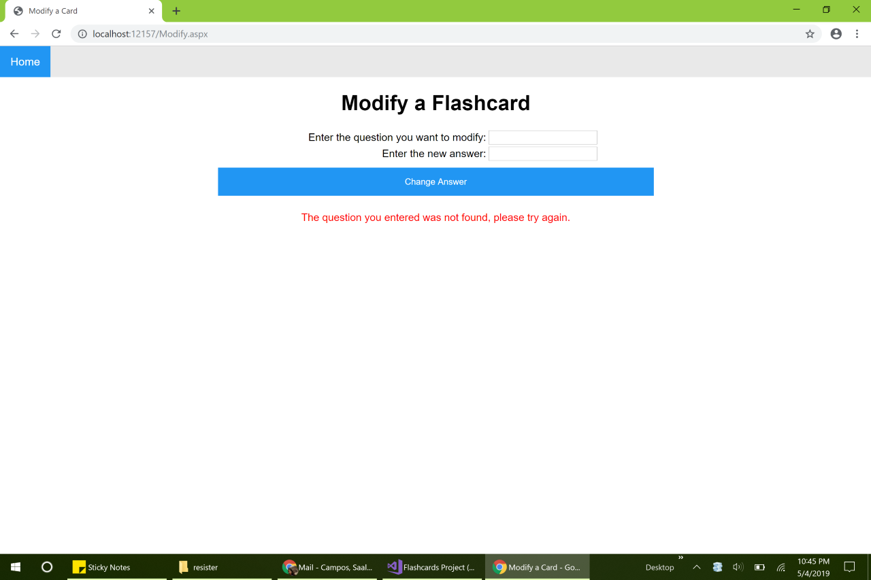

Slide 10
Lessons Learned
Don’t spend too much time trying to settle on a language
Email is not a great medium for project management
Push code to GitHub regularly
MVC would have been a good idea

Slide 11
DEMO

